Slide 1
Predictive Model on SBA 7(a) Loan data FY 2014-2019
- Dinesh Kumar Thirunavukkarasu

Slide 2
Problem Summary
The business problem addressed here is to identify loans with high probability of default and assess underlying risks using historical data
We arrive at a data driven solution using the below given steps:
  Exploratory Data Analysis (EDA)
  Data Wrangling and Feature Selection
  Model building and Evaluation

Slide 3
Key Insights from Data
Dataset Summary:
Initially the dataset has 354270 rows and 43 columns
4 columns has incorrect values
4 columns has more than 50% null values
The dataset has 424 duplicate rows

Slide 4
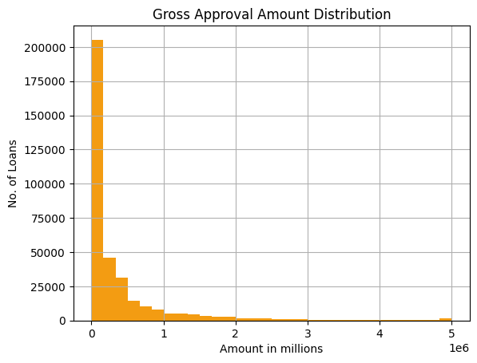
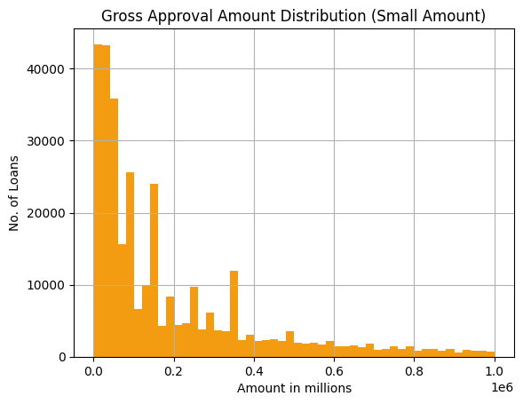
Approved Loan Amount Distribution
The loans approved varies from $1000 - $5M
Most loans were below $200,000
The cummulative amount approved in 2014-2019 was ~$140.66B

Slide 5
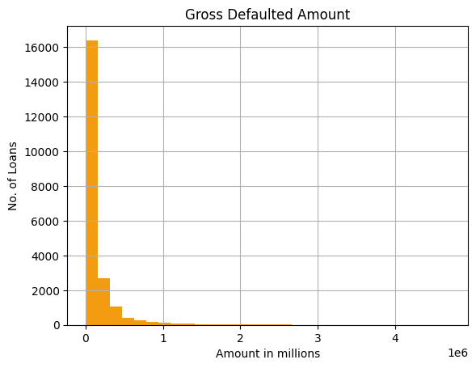
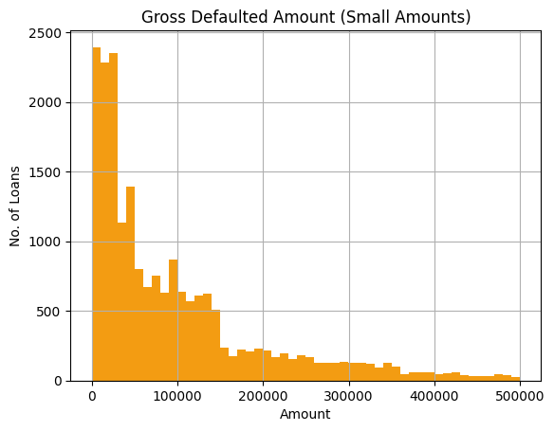
Defaulted Amount Distribution
Gross defaulted amount varies from $11 - ~ $4.7M
A large number of defaults were below $200,000
Total Default amount in 2014-2019 was ~$3.28B

Slide 6
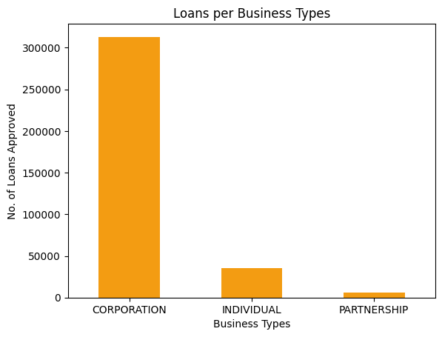
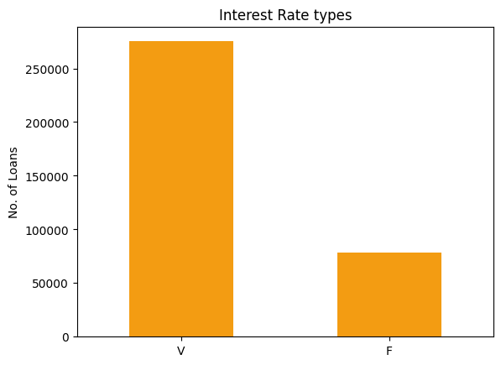
Customer Types and Interest Types
Major customers were Corporations with over 300,000 loans
Over 75% loans were given on Variable Interests

Slide 7
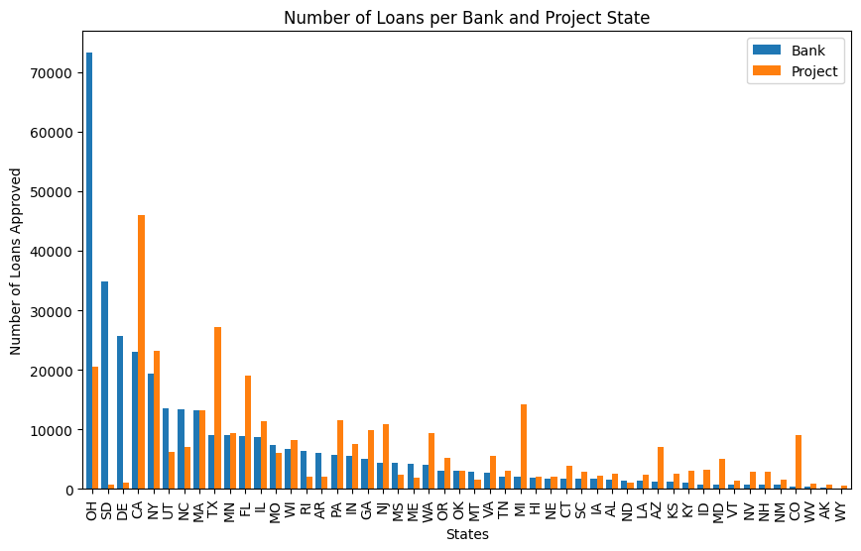
Lender and Customer Demographics
Banks in Ohio gave out the most number of loans with counts over 70,000
Projects based off California has borrowed over 45,000 loans making CA the largest customer base

Slide 8
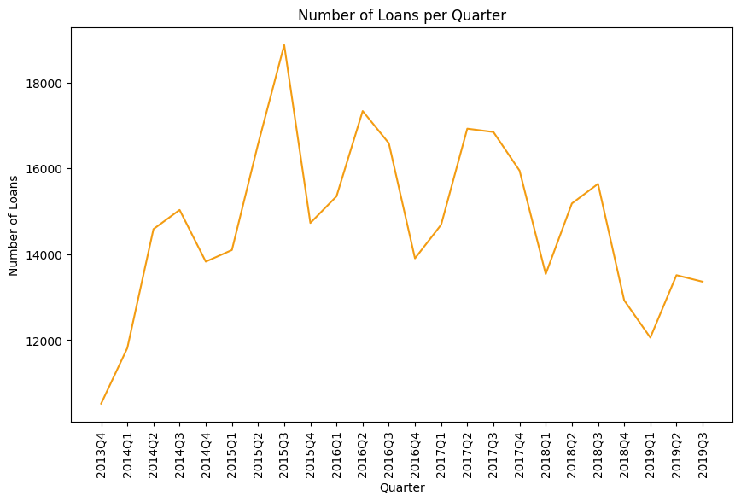
Loan Approval Frequency
The trend shows rise in loan approvals in Q1 and Q2 and a fall in numbers during Q4
The highest number of loans approved were in 2015 Q3 and an overall decrease since

Slide 9
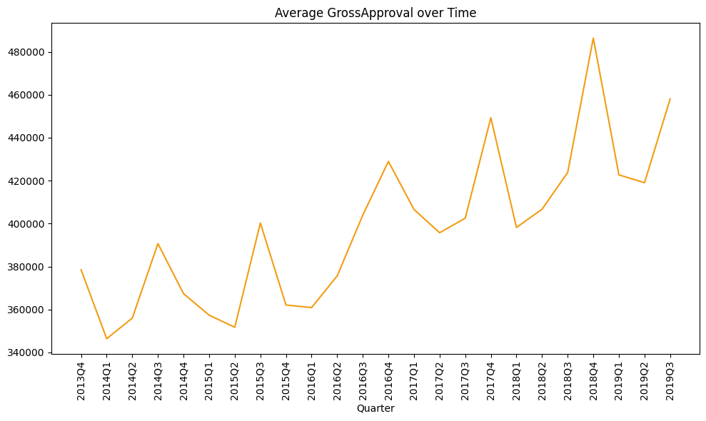
Average Amount approved over Time
In 2014 and 2015 higher values were approved in Q3, but from 2016 - 2019 higher value loans were approved in Q4 with an overall increase in value over time
This trend in relative to loan approval frequency shows inverse relationship between loan value and number of loans approved

Slide 10
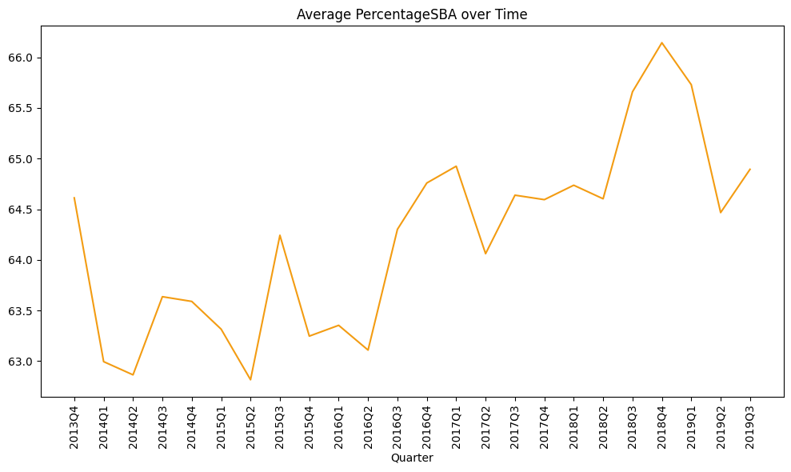
SBA Guarantee Percentage
The SBA Guarantee percentage increases during Q3 and reaches the lowest at Q2.
There is an overall increase in SBA Guarantee percentage over time with an all time highest at ~66% at 2018 Q4

Slide 11
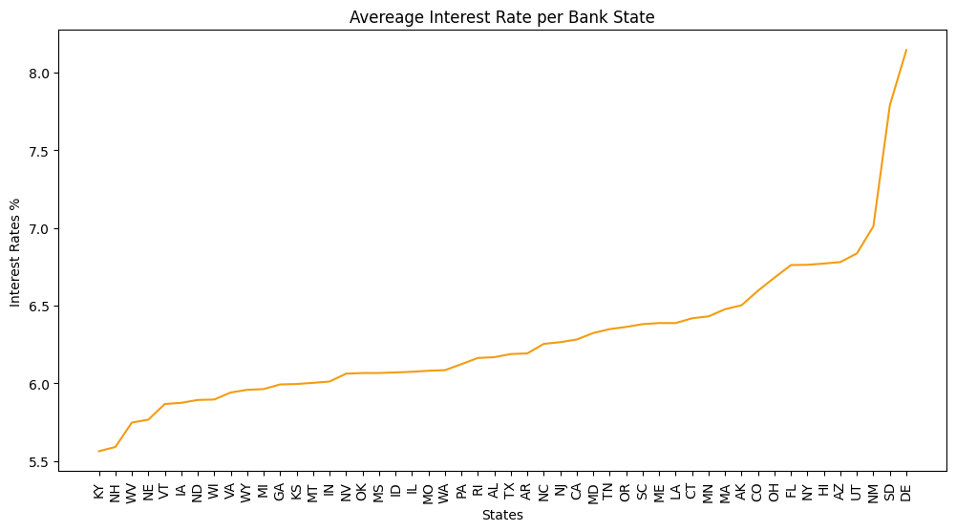
Demographic Trends
Initial Interest Rates:
  Kentucky, New Hampshire and West virginia - <5.75%
  Most banks have interest rates around 5.75% - 6.75%
  New Mexico, South Dakota and Delaware - 7% - 8.25%
  Delaware as highest and Kentucky lowest

Slide 12
Other Trends Observed
Initial Interest Rates saw a steady increase until 2016 and has risen sharply since 2017 Q1 with an all time high in 2019 Q2 at ~8%
Partnership business borrowed higher value loans, with Corporation and Individual following it.
Average loan amount borrowed:
  Partnerships - ~$500,000
  Corporation - ~$400,000
  Individual - ~$200,000

Slide 13
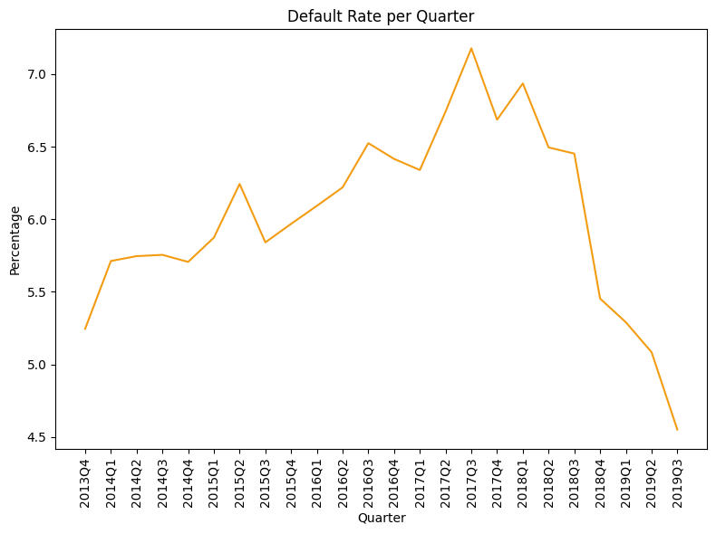
Trends in Default
Default rates have been increasing with peaks at Q3 and all time highest in 2017 Q3 at ~7%.
After 2017 default rates have dropped significantly with an all time low at ~4.5% at 2019 Q3.

Slide 14
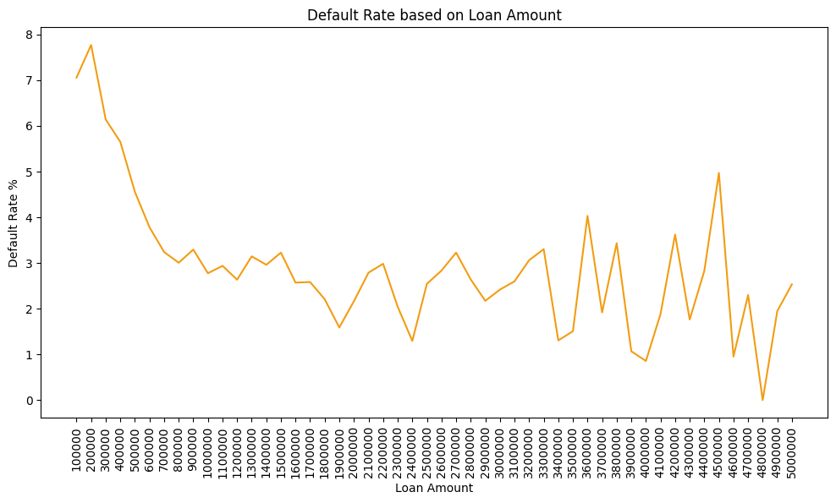
Loans with values less than $500,000 have higher default rate (> 4%)
Loans of values $3.5M - $4.5M also show higher default rate (3% - 4%)

Slide 15
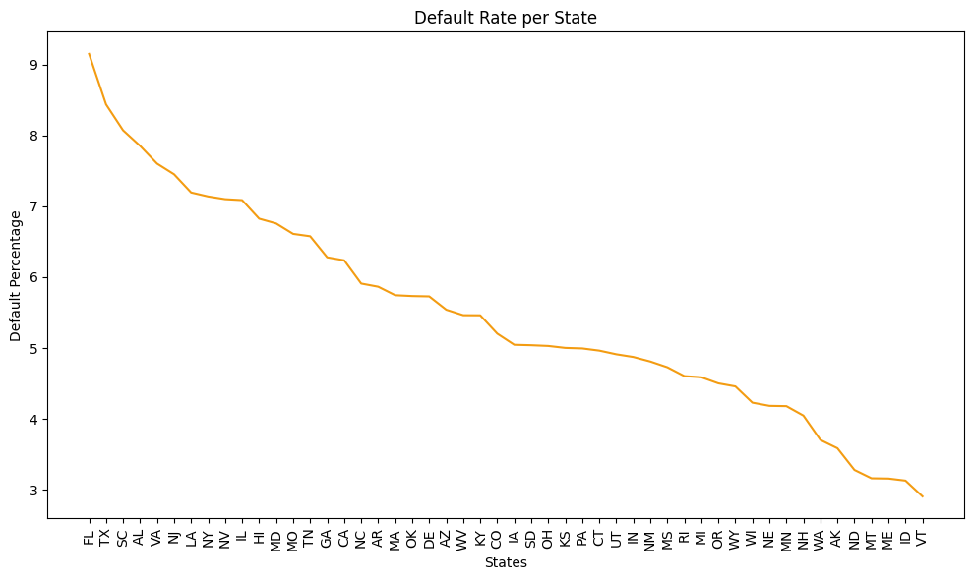
Projects in Florida, Texas and South Carolina tend to default the most (~9.5%, 8.5%, 8% respectively)
Project in Maine, Idhao and Vermont has the lowest default rates

Slide 16
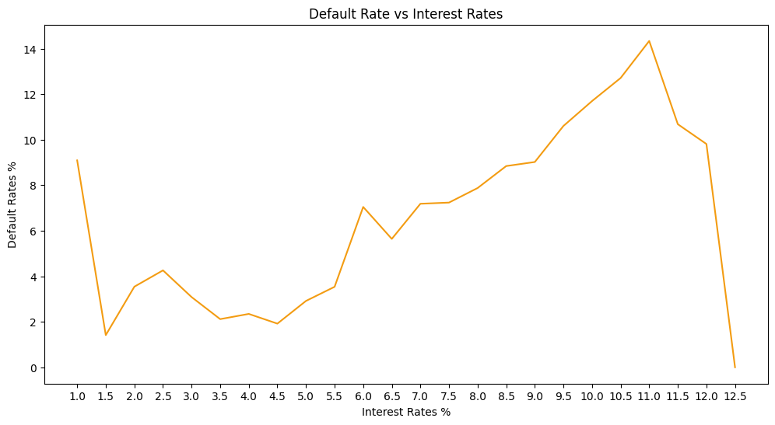
Loans with Initial Interest rates higher than 10% shows higher default rate
Loans with 11% initial interest rate has a default rate of 14%

Slide 17
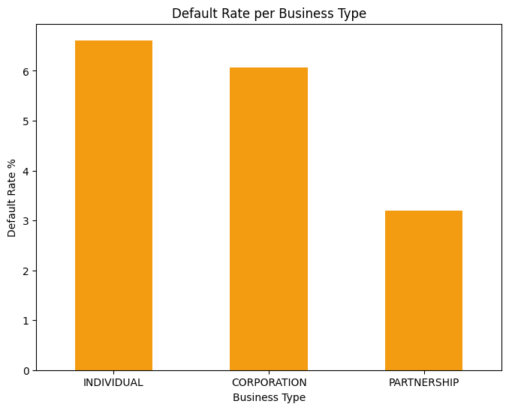
Individual business tends to default the most followed by Corporation and Partnerships.
Individual business has the highest default rate of ~6.5%

Slide 18
Key Drivers of Default
Loans approved in Q3 of a fiscal year
Loan amounts less than $500,000 or between $3.5M - $4.5M
Projects from the southeast US have higher default rate
Individual business tends to default the most
Loans with interest rate greater than 10% have higher default rates

